Slide 1
The ScAvenger’s Hunt
GROUP_11 Full Stack App

Slide 2


Team Members
Harika Kulkarni Pooja Gundu
S538299@nwmissouri.edu S538295@nwmissouri.edu

Slide 3
Overview
A location-based gaming app that assists the user in locating the treasure.
It first compares the device's coordinates to the target position and informs the user whether he or she is inside or outside of it.
When the user clicks/touches the first color, it selects a random location from the database and confirmation message will appear so the user can start the game.
When the user clicks/touches the second color, if the user is inside the treasure location, user will hear information that a treasure is earned.
When the user is outside the target location, user will hear information about help like the direction to walk, how far away or any other clue.

Slide 4
Stack
Platform: Node (v15.0.1)
Web Framework: Express
View engine: EJS
Web App Host: Heroku
ORM: PostgreSQL
Coding standards: Prettier/ESlint

Slide 5
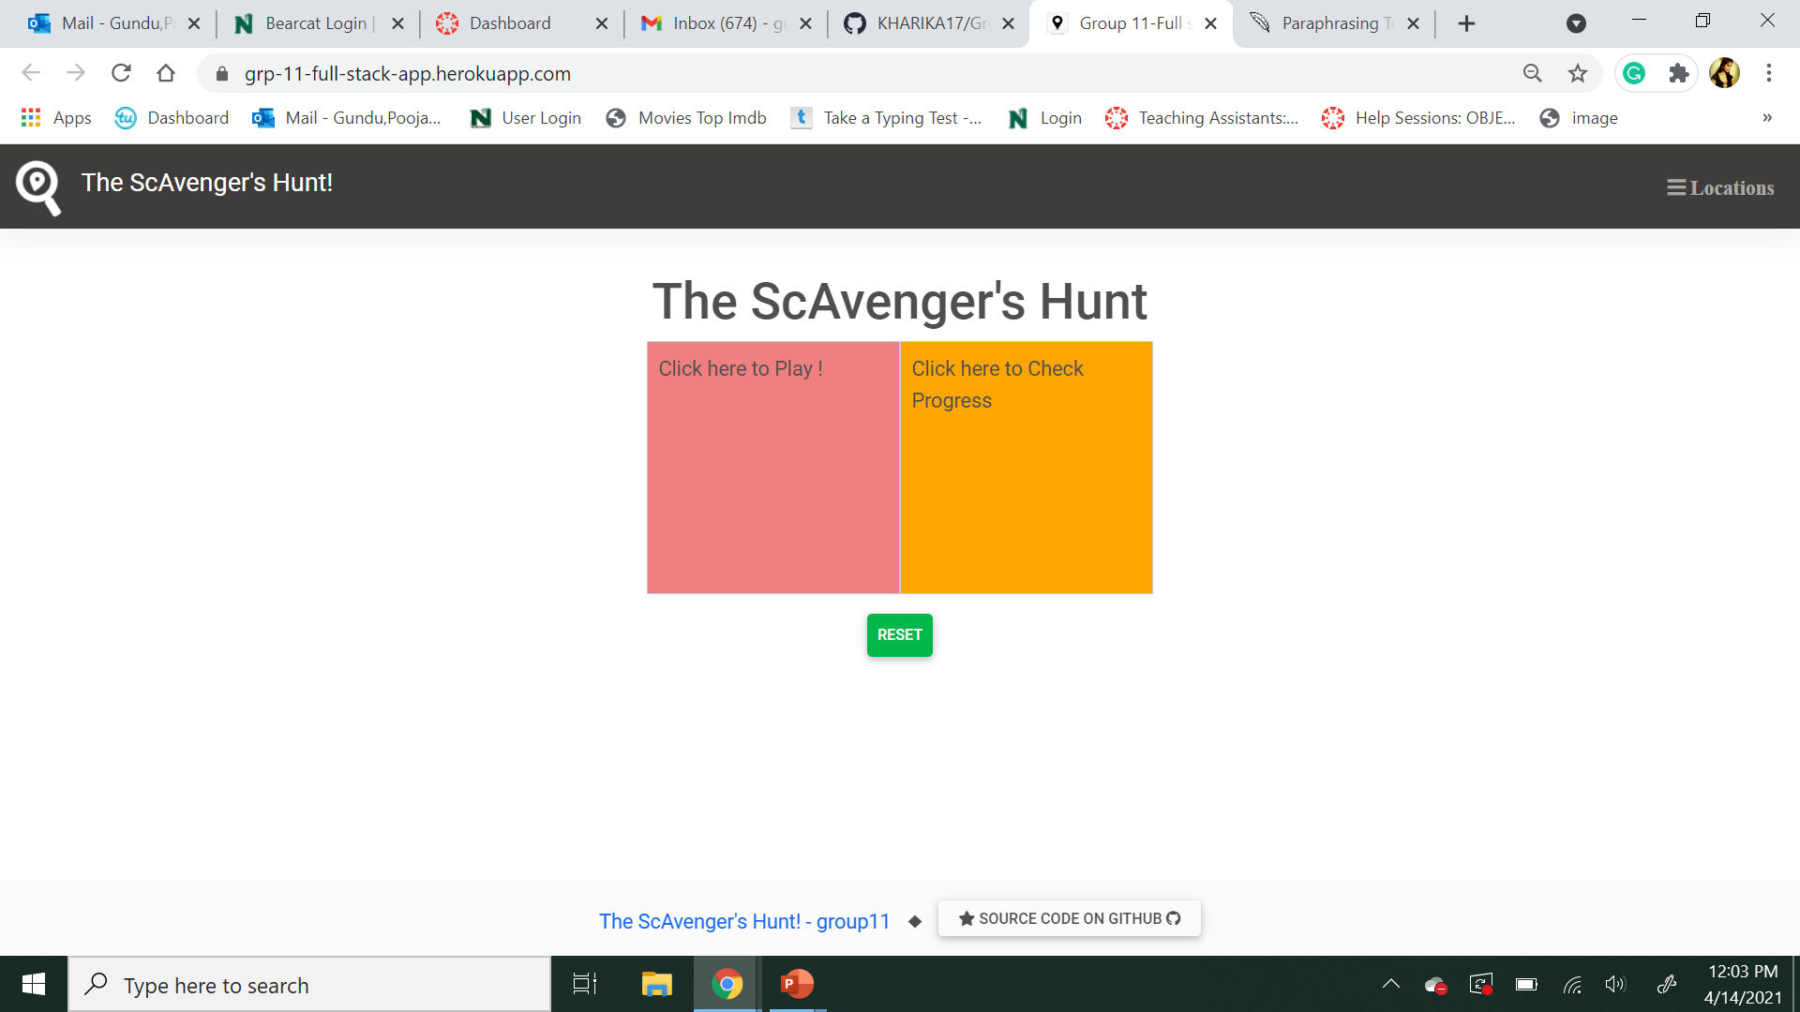
Working app link (Heroku) : Heroku link
Home page of our app :

Slide 6
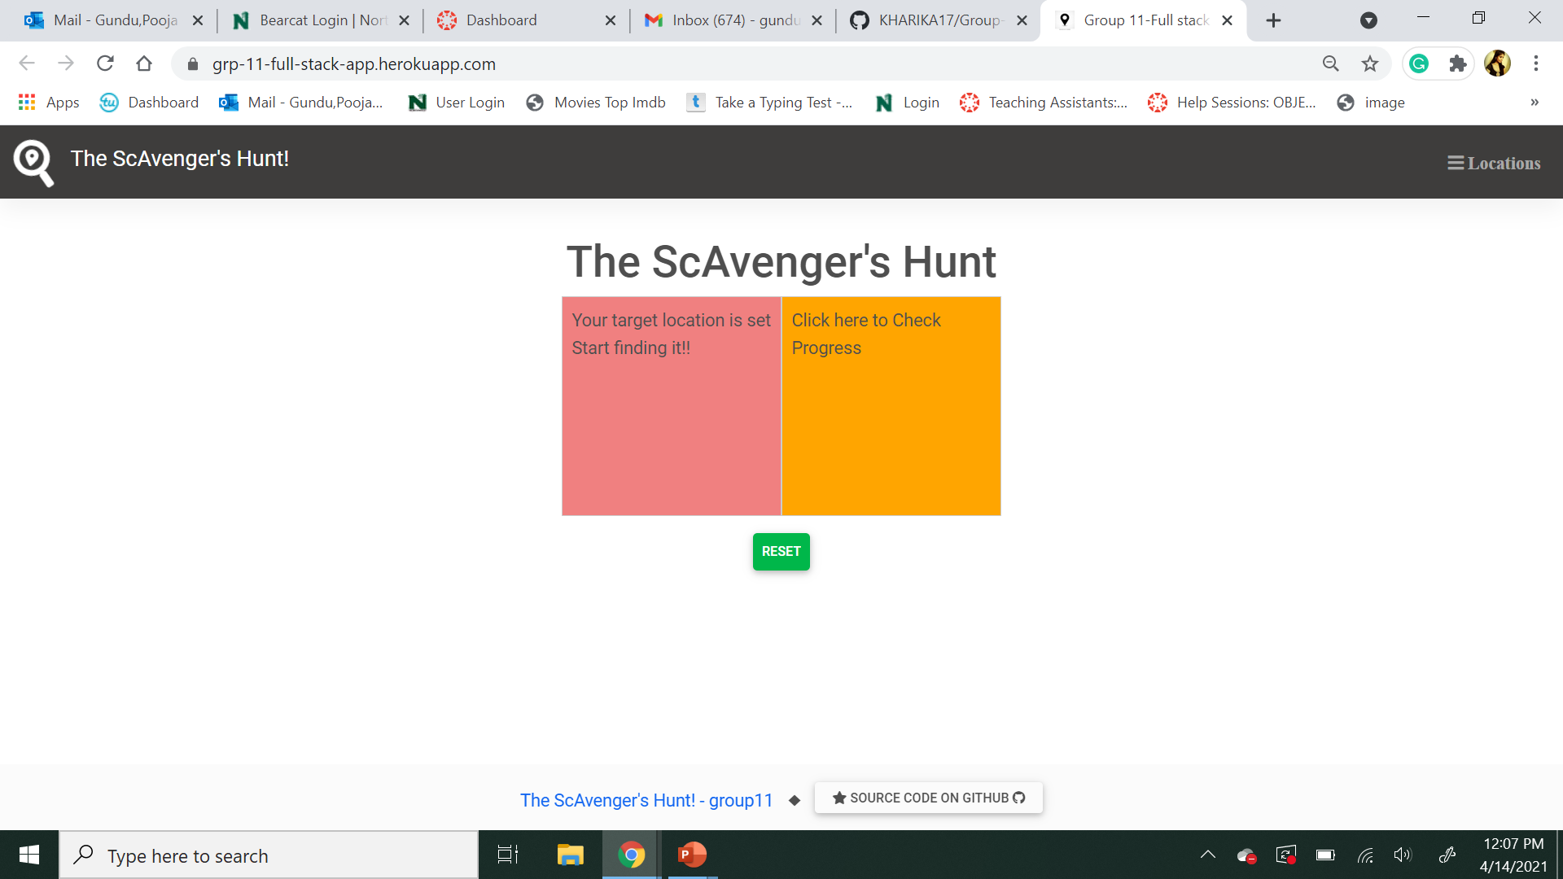
When the user clicks on the first color component to request a valid treasure location.

Slide 7
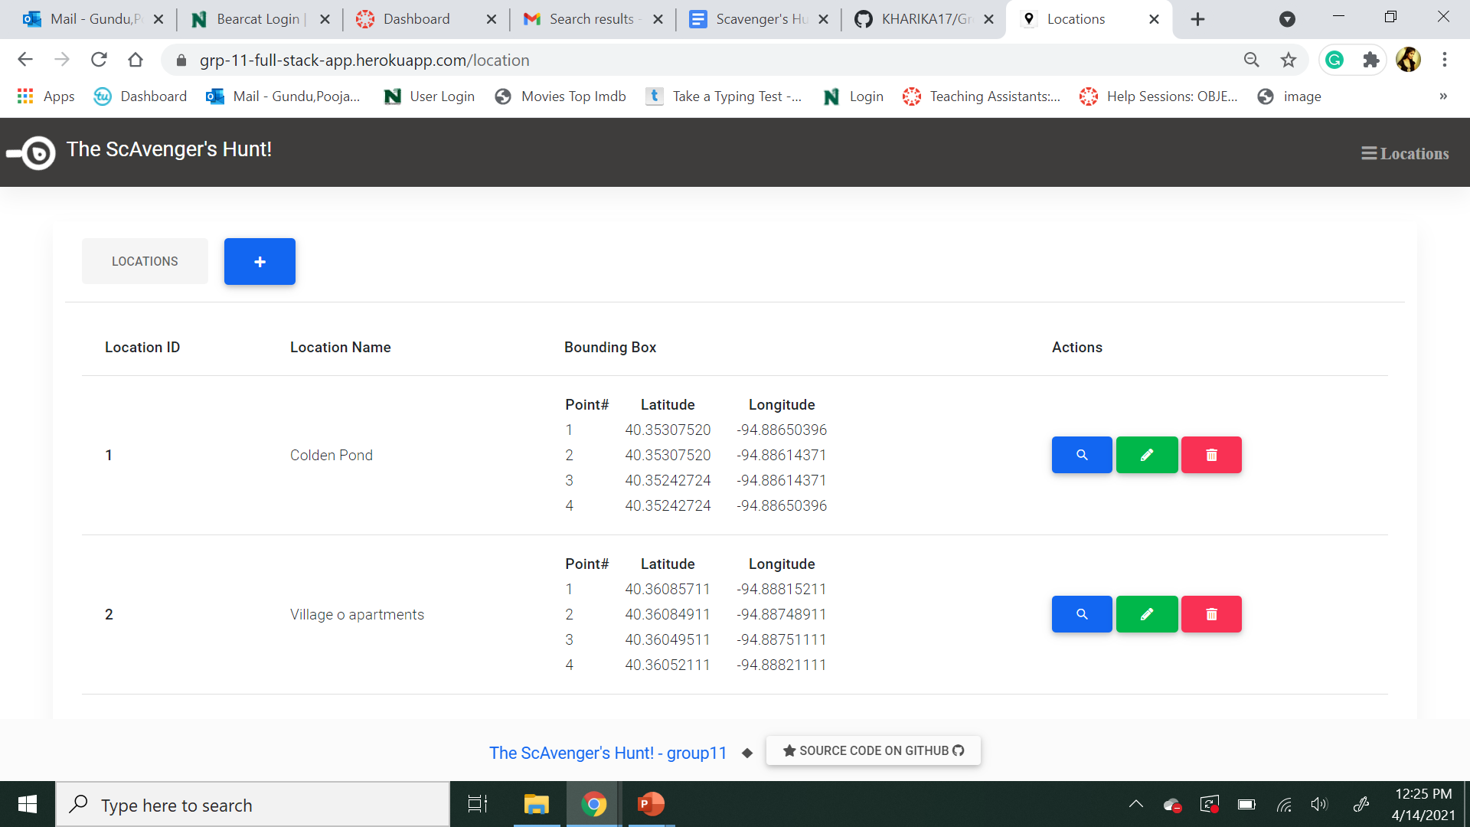
User can do all the CRUD (Create, Read, Update , Delete) Operations for the locations.

Slide 8
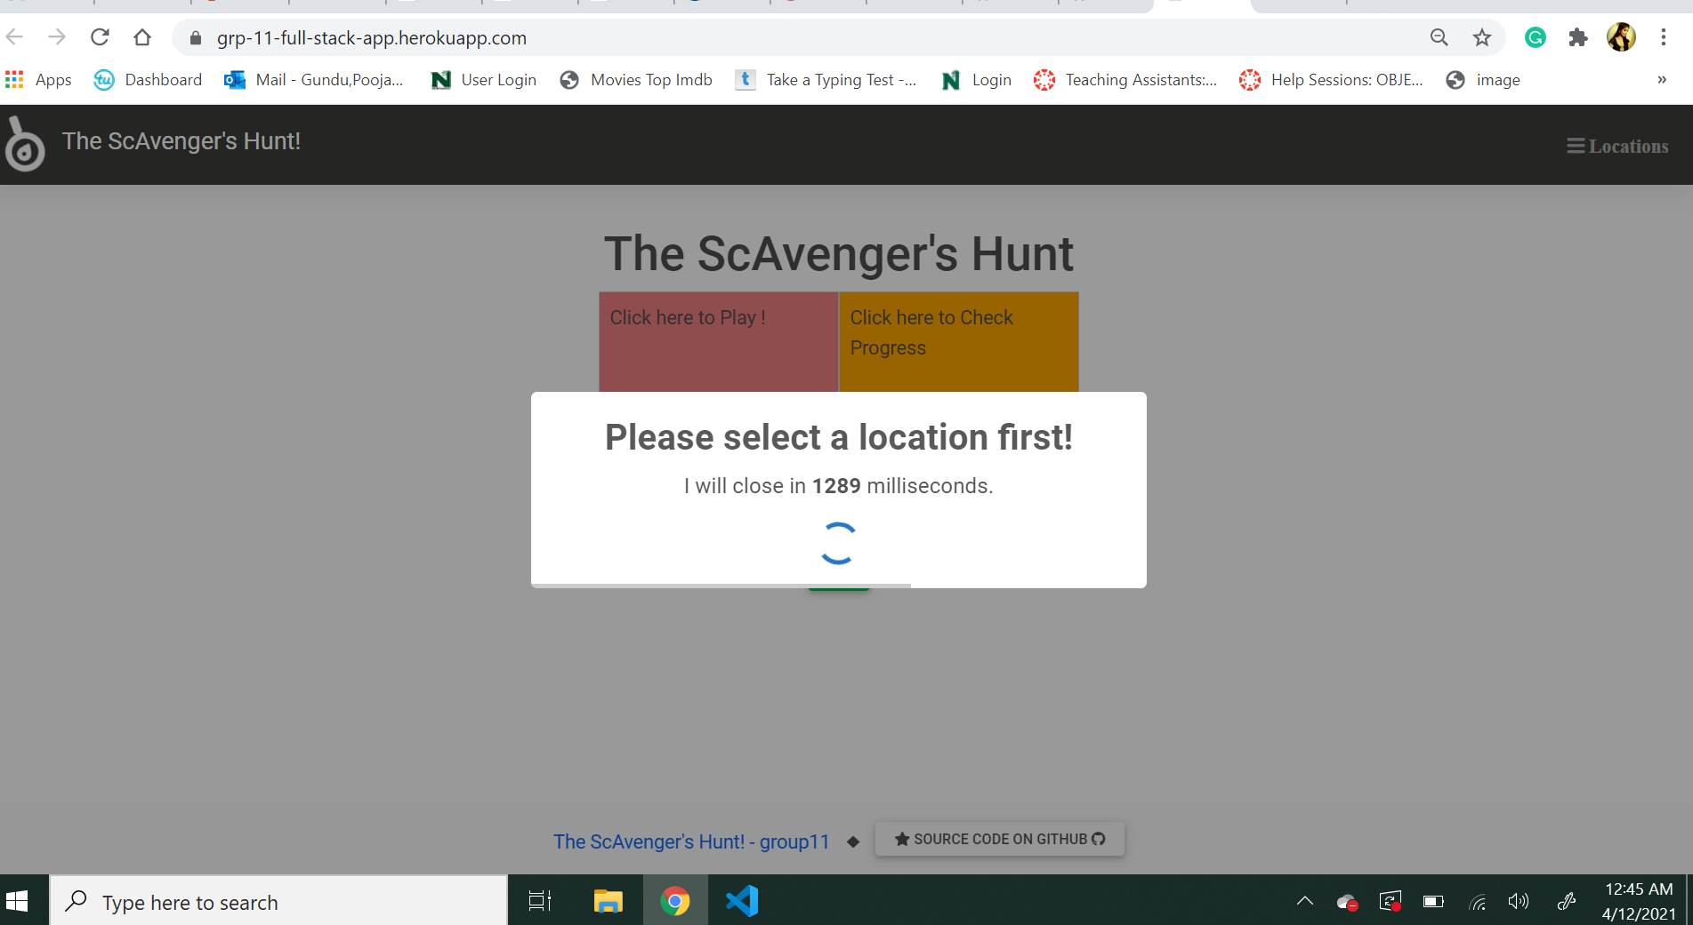
When the user clicks on the second color component, without clicking on the first color component i.e without selecting a location first. It shows a timed popup notification.

Slide 9
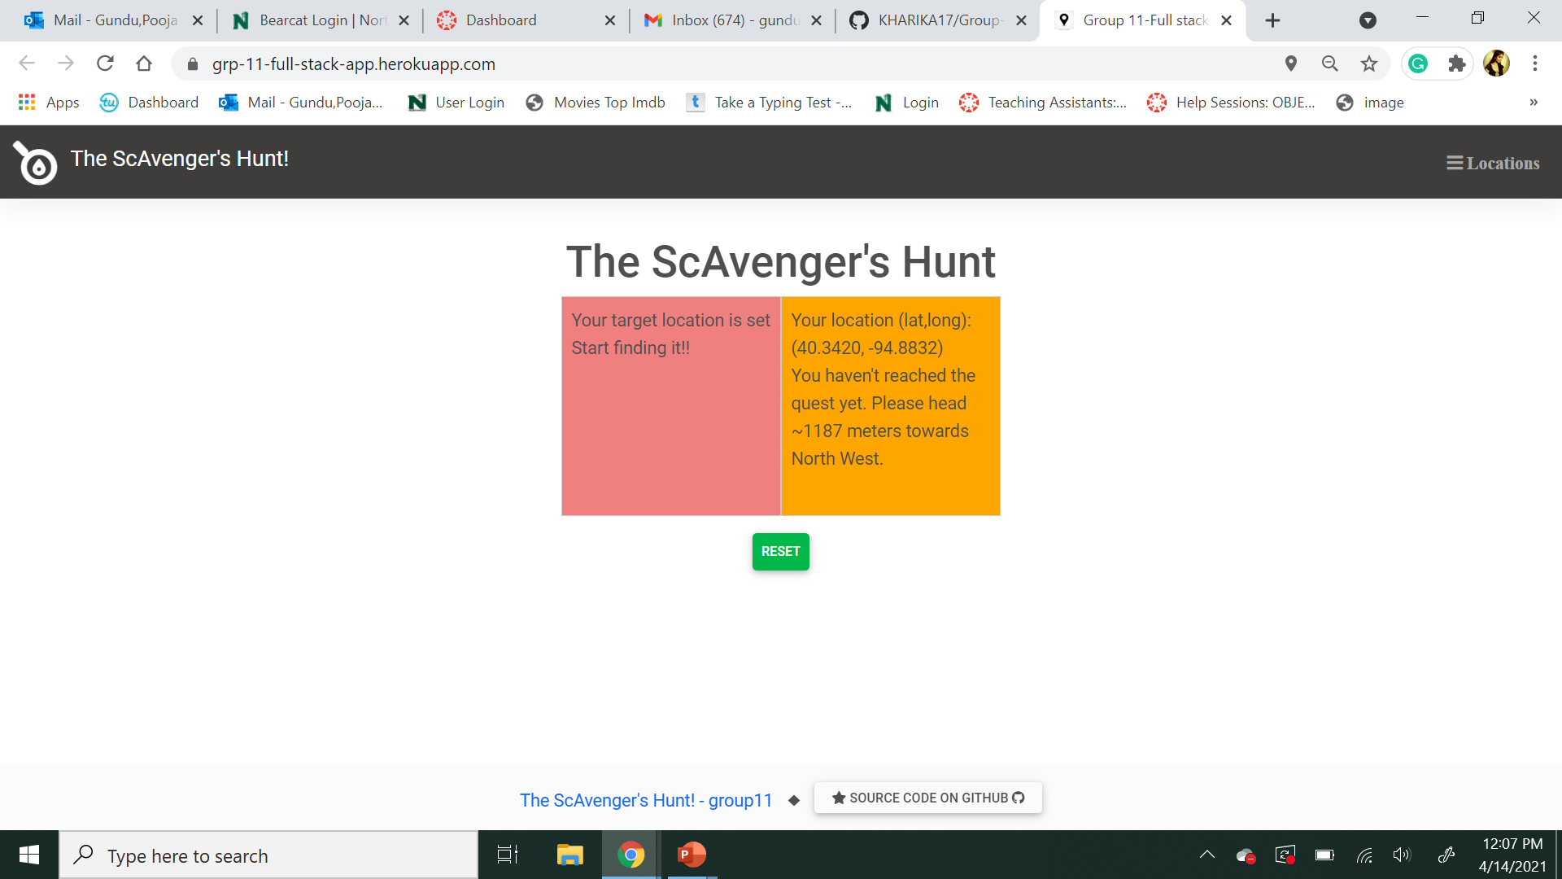
When the user clicks on the second color component, it shows the direction to walk, distance from the treasure location.

Slide 10
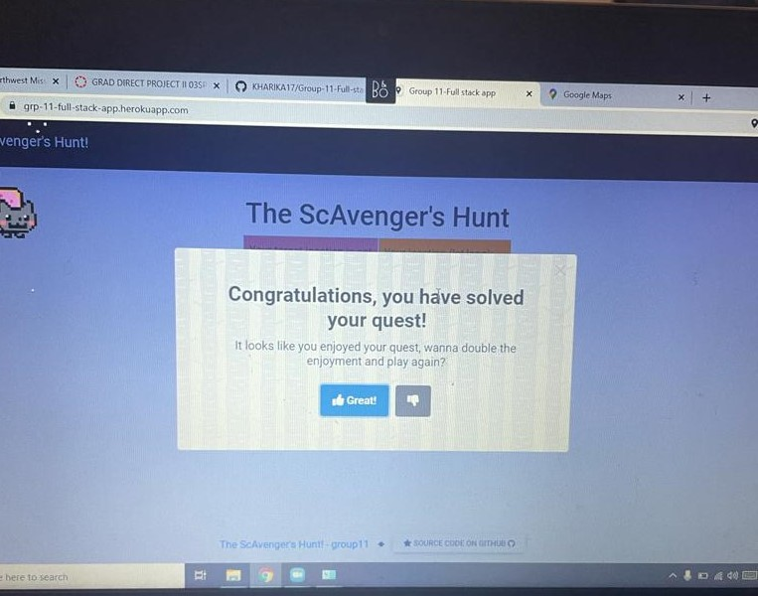
When the user is inside the target location, a popup with animations telling them that they've reached their location and will be given an option to either start the game again or close the popup.

Slide 11
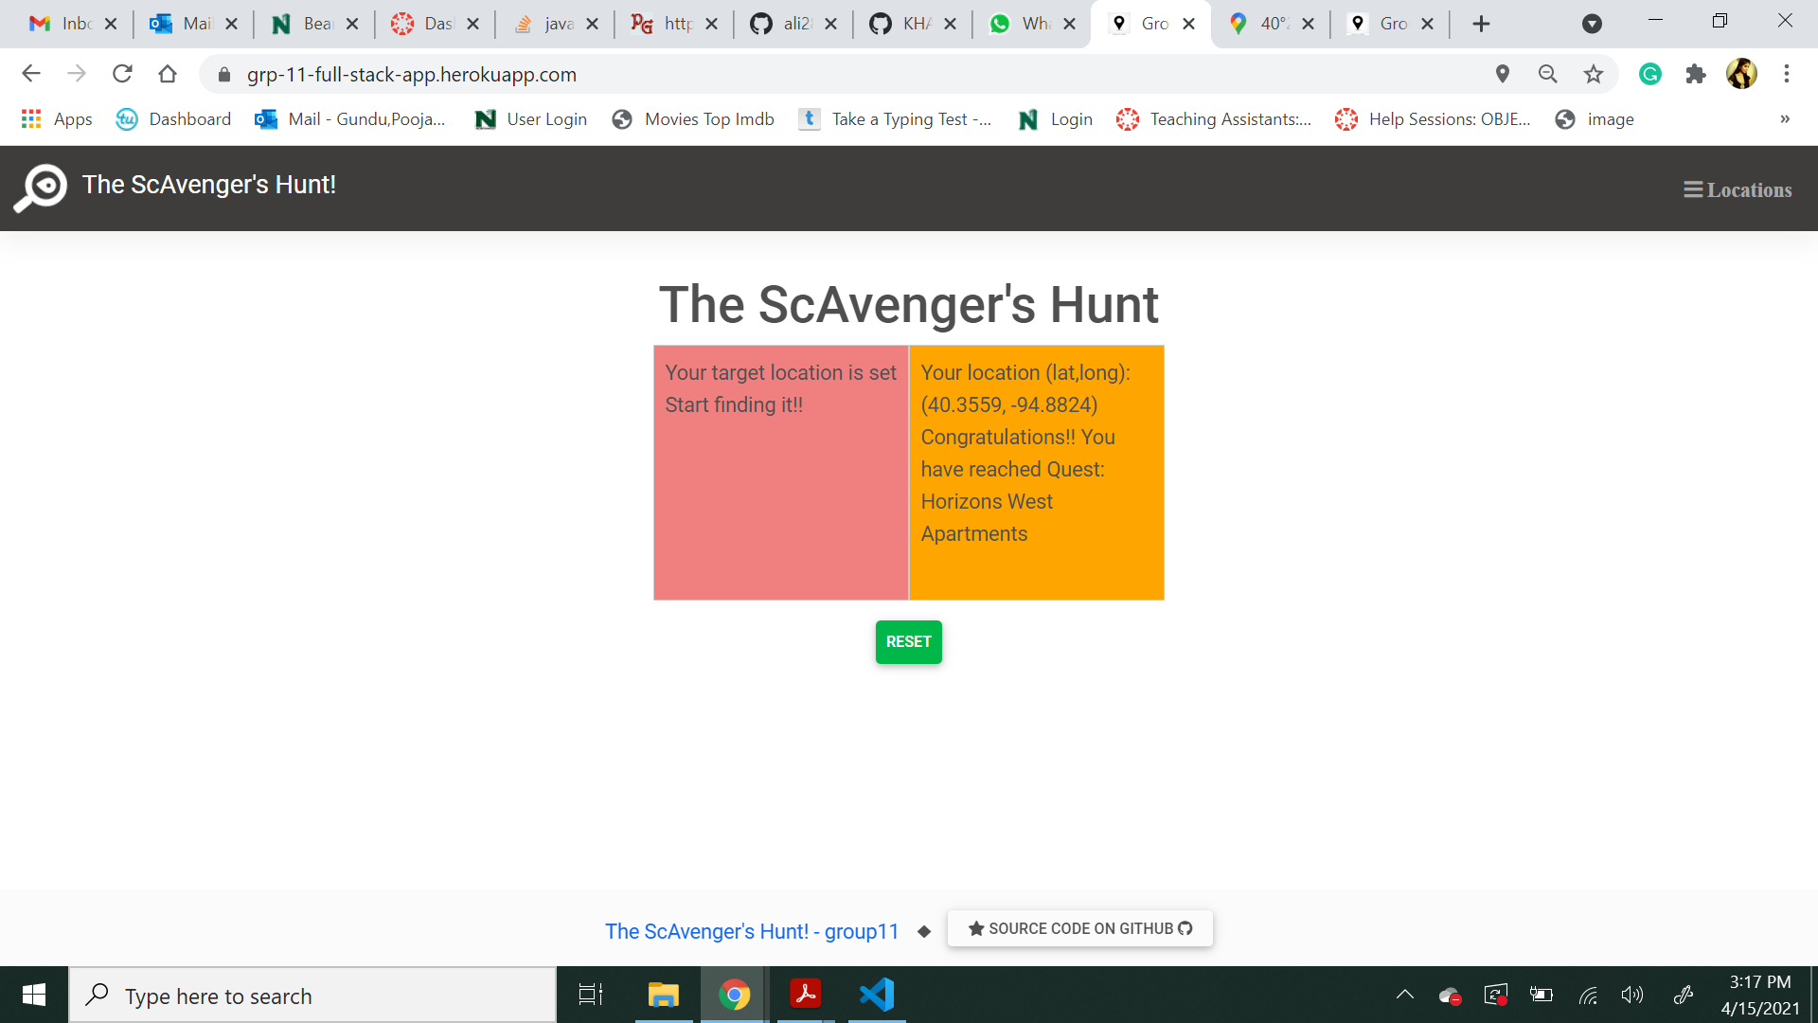

Slide 12


